Slide 1

Team T24Hoop
Team members:
James N
Jarrett Bo
Yassine Be
Damian I
- And others whose names have been redacted
Project Name: HoopNet

Slide 2
Need Statement & Design Criteria
“Urban Roots London needs a way to automatically and manually control their pre-existing systems, namely their hoop house lift-sides and fans, to remove the need to send someone to attend to the houses.”
Obj # | Objective Description | How to Measure | Normalized Weighting*
1 | Not too expensive (Cost effective) | Determine final cost and budget out reasonable costs | 0.277777778
2 | Simple construction (interface, hardware, etc..) | Standardized design and parts (PCB and pre-built parts) | 0.156695157
3 | Flexible, adaptable, and expandable | See if current/future parts allow for easy adaptability/expansion (extra space and support for cameras, motors, sensors, etc..?) | 0.163817664
4 | Feature rich | Compare list of wanted features vs features that are implemented | 0.061253561
5 | Controllable remotely anywhere | Disable Wi-Fi and test in multiple locations | 0.099715100
6 | Cameras for monitoring | Test out the cameras | 0.055555556
7 | Data logging | Leave the system running and checkback on the data | 0.078347578
8 | System notifications | Activate the system and test for alerts | 0.106837607
Cstr # | Constraint Description | How to Verify
1 | Manual override functionality | Test the with test equipment (Ex: a motor or house fan)
2 | Must be designed to last (waterproofing, box strength, wire durability, etc..) | Perform tests to ensure system can last in certain conditions (waterproofing, temperature withstanding, impacts, etc.)
3 | Accurate temperature/humidity readings | Select sensors with low error margin and compare against calibrated temperature/humidity sensors
4 | Limit space used | Ensure the final system size is no bigger necessary like roughly 2 the size of two 8.5 by 11 pages
5 | Easy to construct | Ensure detailed instructions, standardized design, and parts (PCB and pre-built parts)

Slide 3
Project HoopNet: We want to connect Urban Roots’ hoop houses to the internet!
A Raspberry Pi-based control system
That connects to Wi-Fi and a server that we place on UR’s property
The server runs a website that will allow them to remotely monitor their crop, and manual override the lift-sides of their hoop house.
We have plans in place to simplify the installation workload for the client that we will work on when we finish the other phases
“Phase 1”
Our project is in a ‘three-phase’ format: designed so that we complete the most important ‘phase’ of the project first – what the client absolutely needs -- and build onto those foundations when we have the time.
See a brief summary of our three phases on the right, as well as further information in the following slides.
“Phase 2”
“Phase 3”

Slide 4
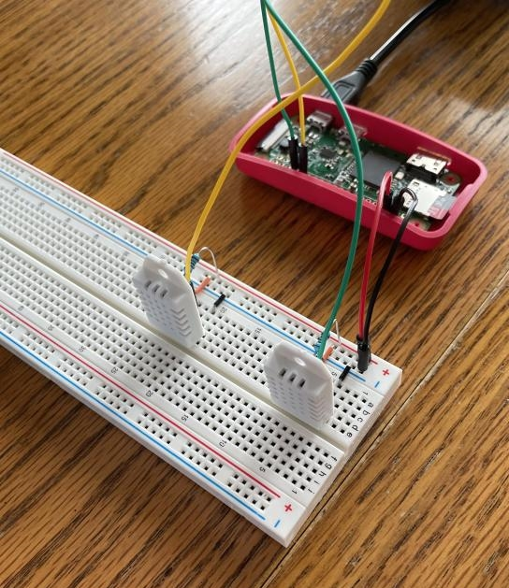
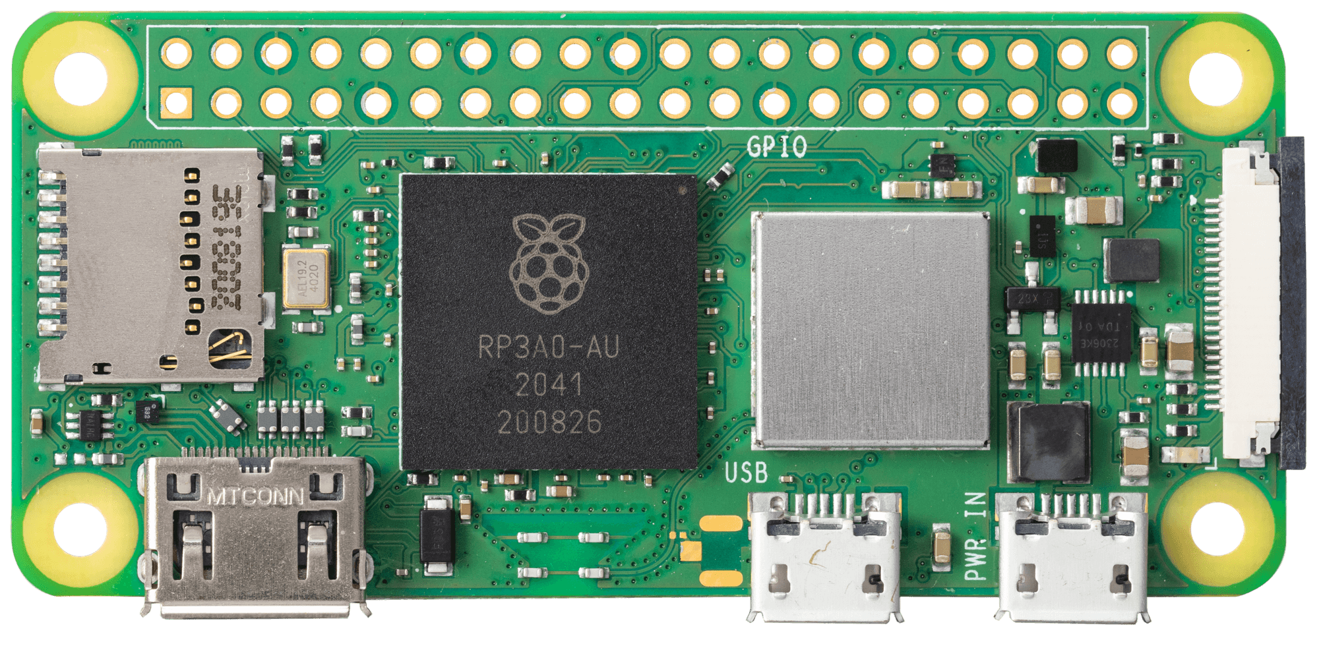
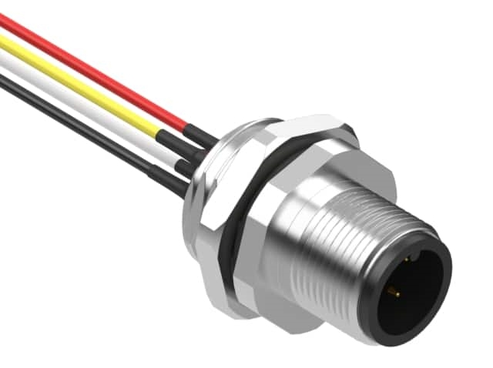
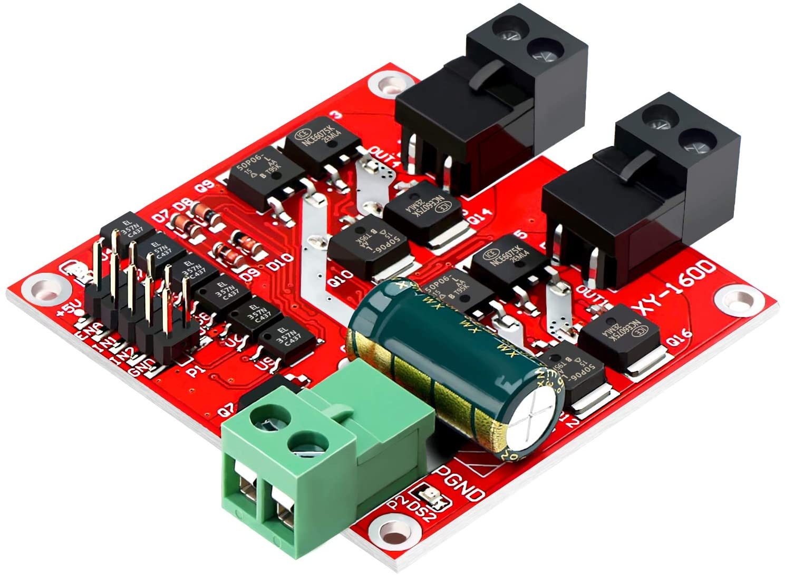
Phase 1: Hoop What are the major systems of automating the hoop houses?
Input
Brains
Output
Raspberry Pi Zero 2 W
Built in Wi-Fi, lots of ports
We’re very familiar with its coding language
Make backups of it with an SD card!
This is where we tie into (some of) what the client already has!
Lift sides are controlled by a motor controller, wired into the Pi
Includes all the humidity and temperature sensors.
Our final version will have the sensors attached to some sort of plug-and-play waterproof cable

Slide 5
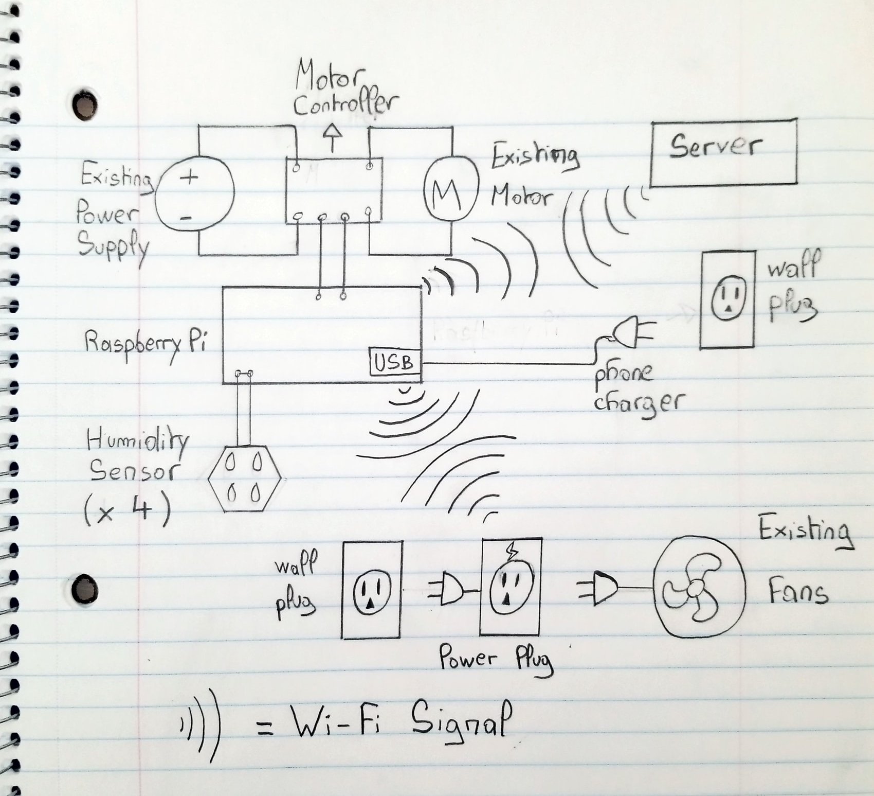
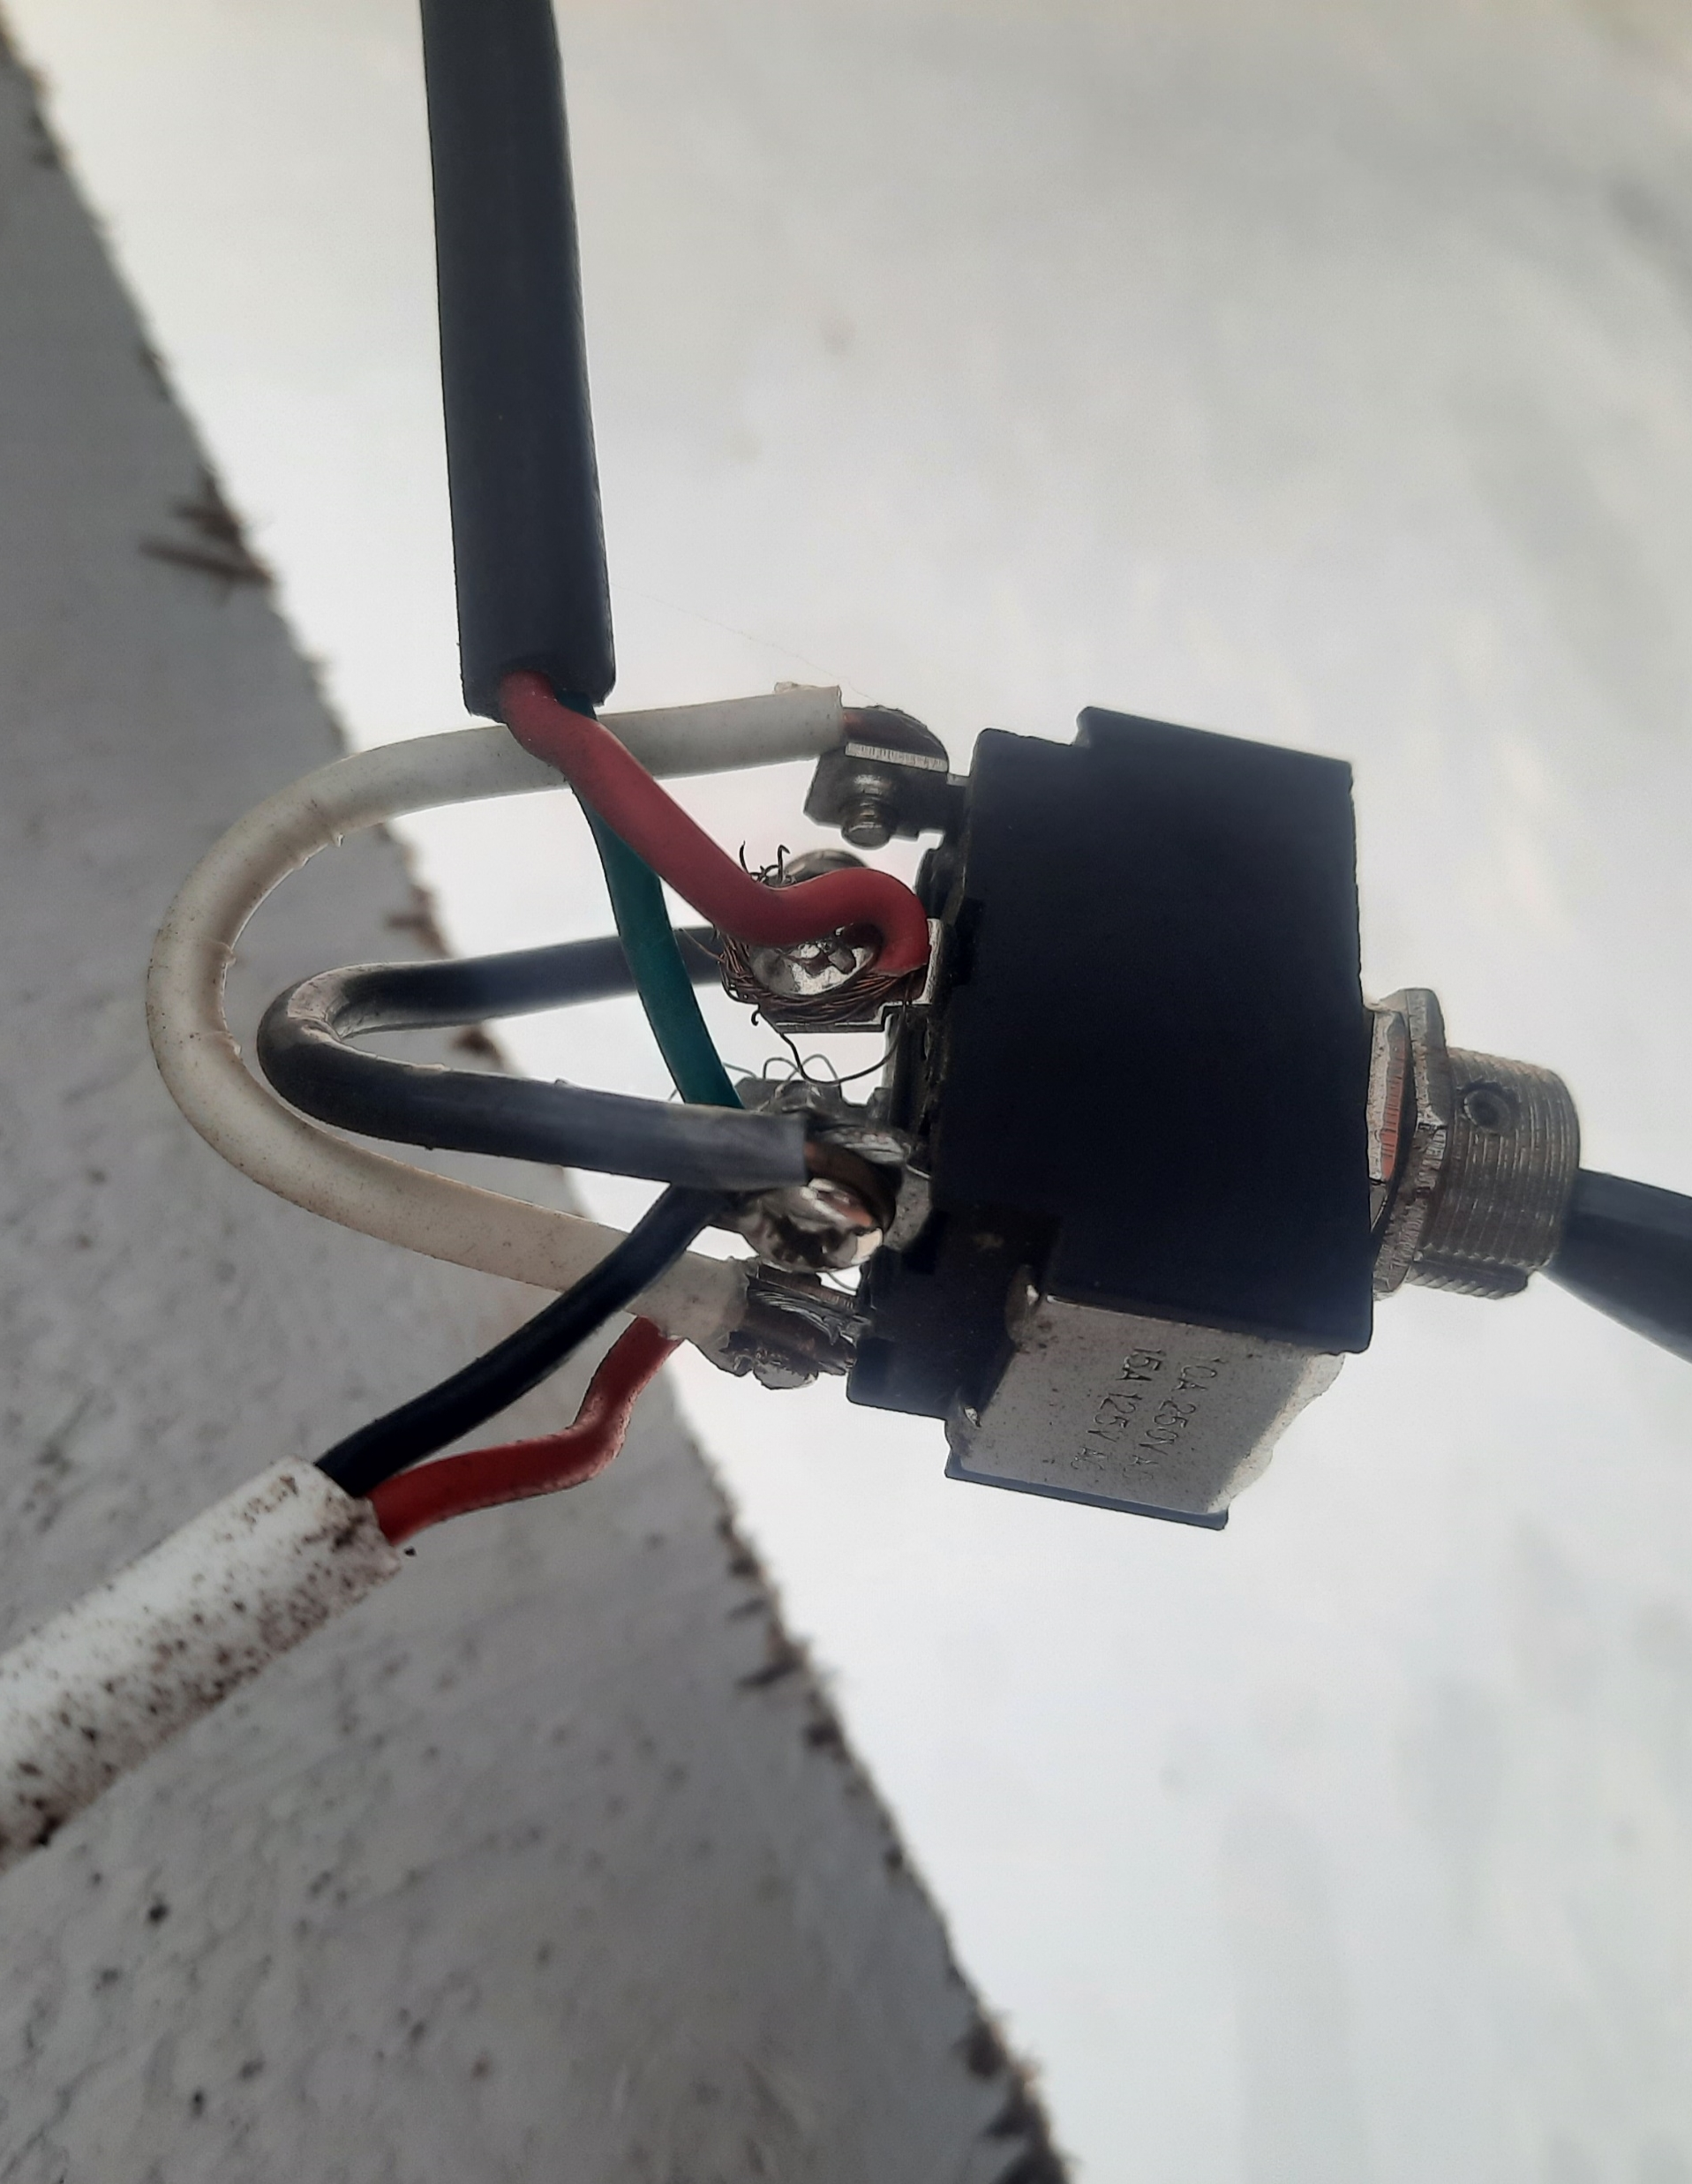
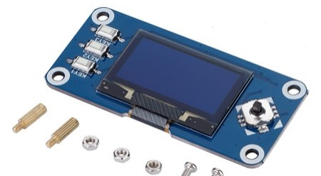













Control System Diagrams
How we are going to connect the Raspberry Pi
Overall view of the control system
The client was very adamant about the addition of a manual override.
We will handle that both in Phase 2 and Phase 1 with a screen.

Slide 6
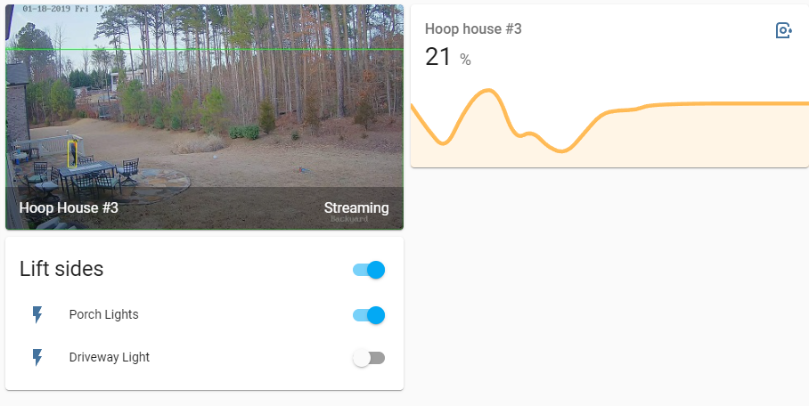
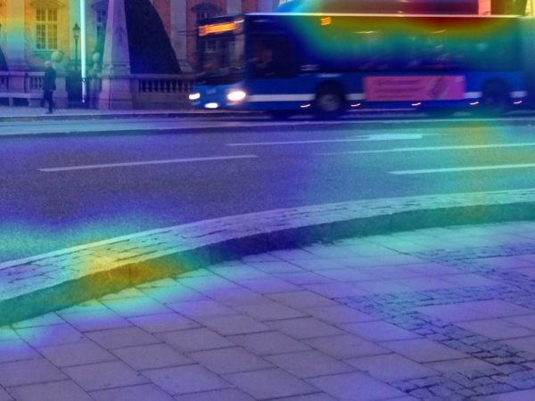
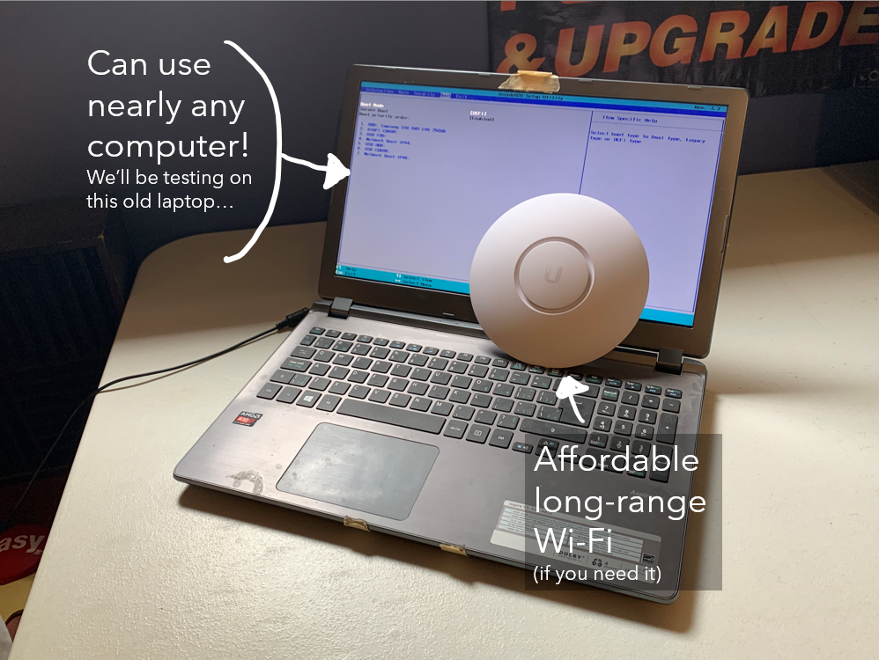
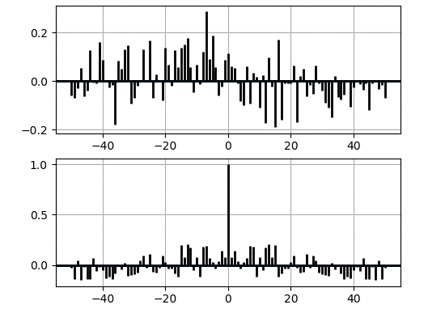




Phase 2: Net How are we getting the hoop houses online?
Talk to the Pi’s without interfering in their work
The Pi’s handle lifting and lowering the doors, the server just collects info from them
Host a website!
The client can securely check on what the Pi’s are doing
The client can even put in cameras, if they want them!
Manual override, remotely
You can instruct the system to keep a lift door open for some amount of time or indefinitely
Collect data!
Ben (the client) told us he likes data, so here is what we can do with the server
Heatmaps
Humidity vs time
(or temperature)

Slide 7

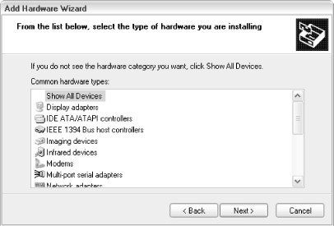
Phase 3: Simplicity How will we make this complex system easier to set up?
PCBs with plug-and-play connections
No soldering required!
Premade software ‘images’
Saves the client code-configuration work
Let’s them backup the software just in case!
Installation wizard

Slide 8
Bill of Materials
Part | Quantity | Total Price | Already acquired ? | Link
Humidity and Temperature Sensor | 8 | $ 88.00 | Yes, 2 for prototyping | https://www.amazon.ca/Digital-Temperature-Humidity-Replace-Raspberry/dp/B07L3GJH7J/ref=sr_1_26
Motor Controller | 2 | $ 50.00 | No, but we're using a $13, lower scale one for prototyping | https://www.amazon.ca/DROK-Industrial-Controller-Optocoupler-Isolation/dp/B06XGD5SCB?th=1
Raspberry Pi Zero 2 W | 2 | $ 38.00 | No, but we're testing with the Pi Zero 1 W | https://www.pishop.ca/product/raspberry-pi-zero-2-w/
Waterproof Project Box for Pi Zero 2 W | 2 | $ 30.00 | No need to, specific for installation in the hoop house | https://www.amazon.ca/LeMotech-Plastic-Electrical-Project-Junction/dp/B07F462RYR/ref=sr_1_13_sspa
Small LCD Screen | 2 | $ 17.00 | No need to, specific for installation in the hoop house | https://www.amazon.ca/DSD-TECH-SH-D1602-Interface-Raspberry/dp/B07T8S3P1M/ref=asc_df_B07T8S3P1M/
Manual Override Button (nice big and red) | 2 | $ 3.26 | No need to, specific for installation in the hoop house | https://www.digikey.ca/en/products/detail/c-k/D6C40-F2-LFS/1466342
Waterproof Cable Assembly | 8 | $ 77.16 | No need to, specific for installation in the hoop house | https://www.digikey.ca/en/products/detail/cnc-tech/1072M12-03-1-1-S-00050/11203841
Raspberry Pi 4 for hosting the server | 1 | $ 73.00 | No, we're prototyping with and old laptop | https://www.pishop.ca/product/raspberry-pi-4-model-b-4gb/
120gb SSD for the server | 1 | $ 33.00 | No need to, specific for installation in the hoop house | https://www.amazon.ca/Netac-Solid-State-Drive-N530S/dp/B088BVGW54/ref=sr_1_2_sspa
USB to SATA adapter | 1 | $ 13.00 | No need to, specific for installation in the hoop house | https://www.amazon.ca/Sabrent-2-5-Inch-Adapter-Optimized-EC-SSHD/dp/B011M8YACM/ref=pd_lpo_3

Slide 9
Plan / Schedule
← This is an embedded chart – you can double-click / zoom in!

